Slide 1
Telecom Churn Analysis
Nirmal Patel

Slide 2
Disclaimer
No personal information was included
The sample data does not have a time frame of when the data was collected

Slide 3
DATA

Slide 4
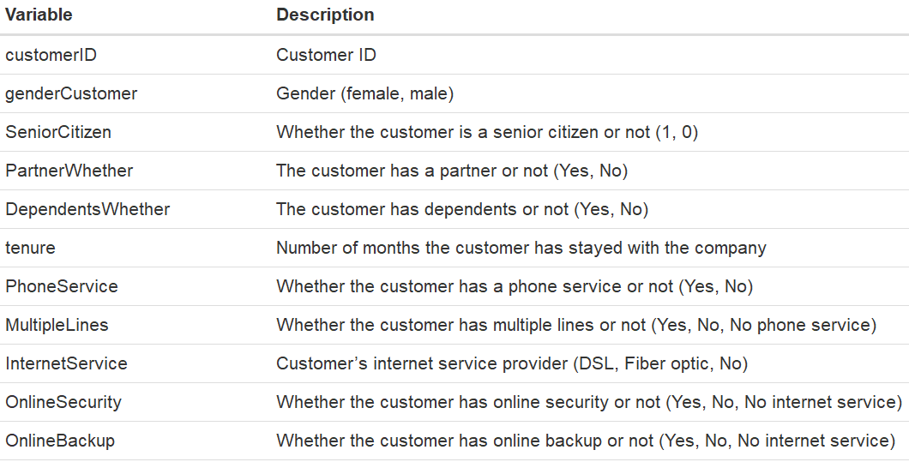
Data
Data overview
21 original columns
7044 records
Removed Column
TotalCharges- The total charges column was removed because the data was not uniform as some charges includes monthly rates and others were for multiple months. This column also had 11 NA’s

Slide 5
Exploratory Analysis

Slide 6
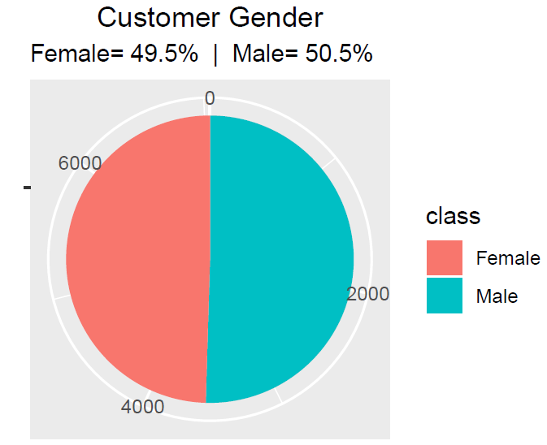
Gender
Are men more likely to have coverage?
The data set accounted for
Female 49.5%
Male 50.5%
The gender distribution of customers seems balanced with both genders accounting for close to 50% of the data set

Slide 7
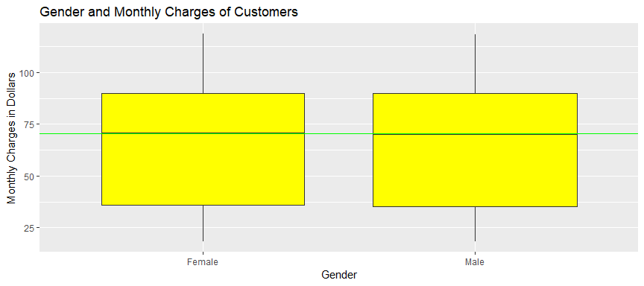
Gender and Monthly Charges
Does one gender pay more monthly charges?
It seems that both male and female customers pay about the same with a median of $70.35
This data only includes the monthly cost and does not categorize by each service cost service

Slide 8
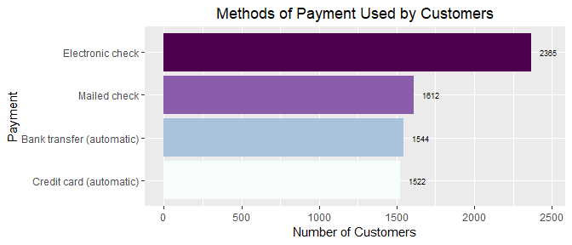
Payment
What is the most common form of payment (most common to least common)
Electronic check > Mailed check > Bank transfer (automatic) > Credit card (automatic)

Slide 9

Monthly Charges
What is the range of monthly charges?
The monthly charges range from $18.25 to $118.75 per month.
The mean/average monthly bill is $64.76.
The median bill is $70.35.
The maximum monthly charge is $118.75

Slide 10
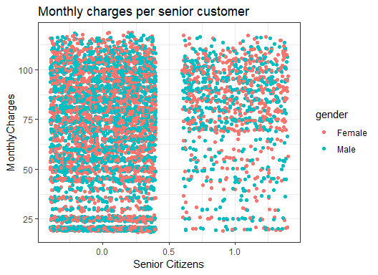
Senior Citizens
Do senior citizens get a discount?
The ranges of minimum and maximum monthly charges are similar Senior citizens as for non senior customers.
However, the majority of Senior Citizens seem to be paying above ~$70.

Slide 11
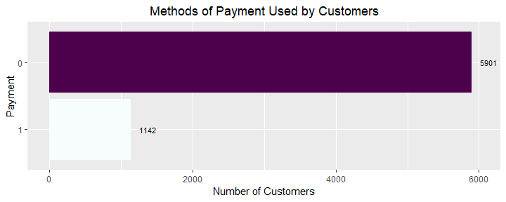
Senior Citizens (cont.)
Are there more senior customers?
Non Senior Customers/Regular customers (Purple) = 5901 customers
Senior Customers (White) =1142 customers

Slide 12
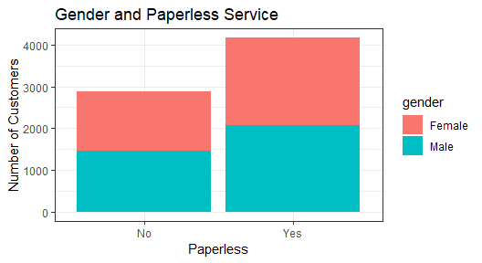
Paperless
Does it have a higher percentage of paperless billing?
59% have paperless billing set up
41% receive a paper copy of the bill.
How ecofriendly is the company?
The company has a decent ecofriendly initiative but they can improve it by giving an incentive to go paperless, which would save the company on stationary supplies such as paper, ink, and postage.

Slide 13
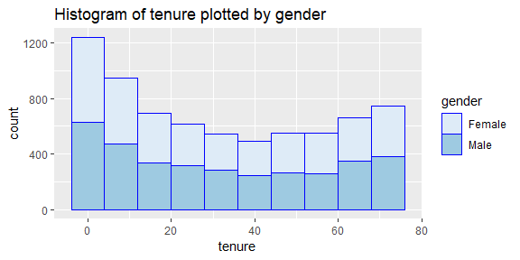
Customer Tenure
Which months are critical for keeping the customer?
Between 0 to 40 months the customer is likely to churn
After 40 months the customer is more likely to stay.

Slide 14
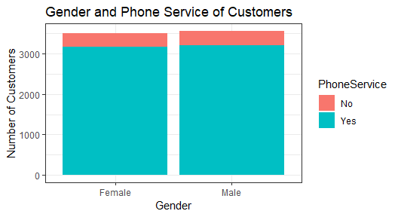

Gender and Phone service
Is a particular gender more likely to have a phone service with our company?
44.8% women with phone service
4.7% women do not.
45.5% male customers have the phone service
5% male do not have the phone service.

Slide 15
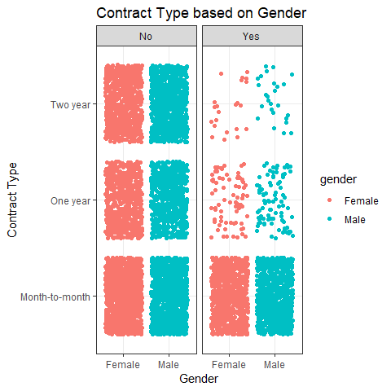
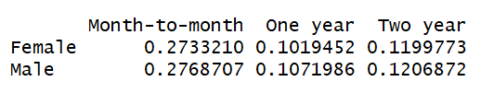
Gender and Preferred Type of Payment
Do more men or women prefer each type of contract? Month-to-month, One year, Two year?
There seems to be an equal number of male and women per Contract type.
What happens if we separate this by the churn variable?
Month to month customers where most likely to churn
One year contractees were less likely to churn
Two year contractees were least likely to churn.

Slide 16
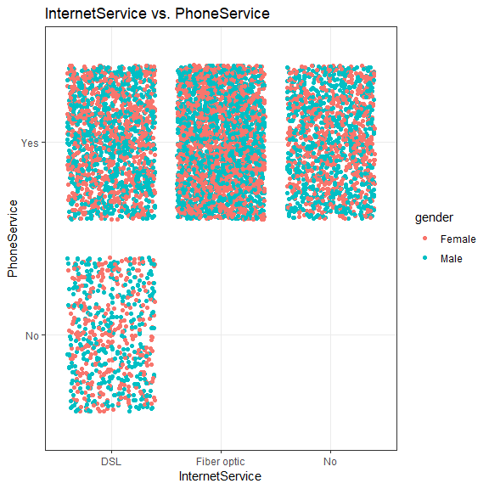
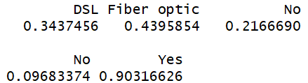
Internet or Phone sells more
What is more common phone service or internet service?
78.3% have Internet service
90% have phone service.
Phone service is more common. This may lead to the company having to work more on marketing a better way to increase internet sales.

Slide 17
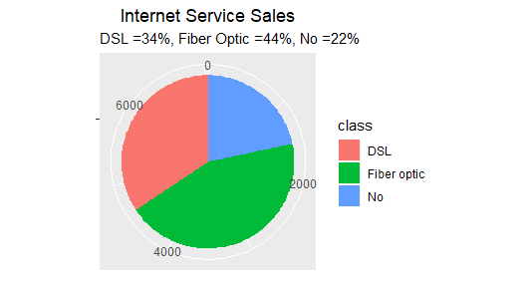
Internet Sales
Which types of internet service are most commonly bought?
DSL = 34%
Fiber Optic = 44%
No internet service = 22%

Slide 18
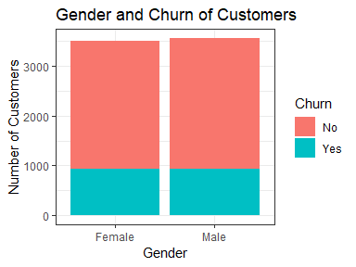

Gender and Churn
What percentage of customers stay based on gender?
73.5% stayed with the company.
36.2% where female
37.3% where male.
26.5% of customers churned
13.3% where female
13.2% were male.

Slide 19
Machine Learning Logistic Regression

Slide 20
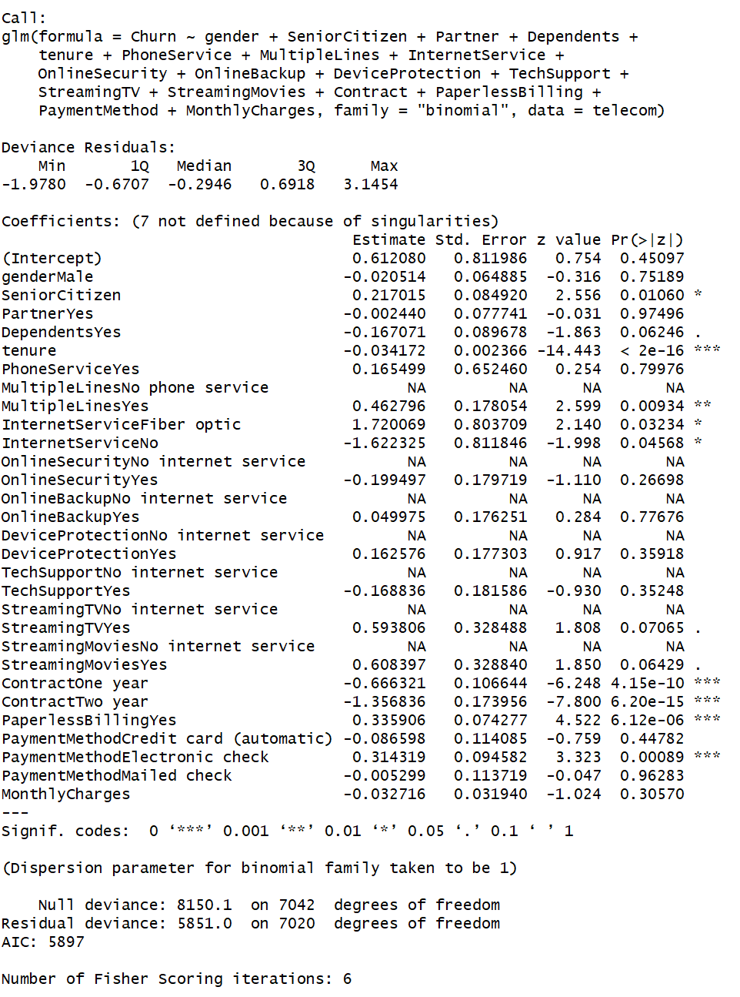
Variables I included
Gender
Senior Citizen
Tenure
Multiple Lines
Internet Service
Contract
Paperless Billing
Payment Method
Monthly Charge

Slide 21


Split the data into and test the model
Use logistic regression for churn prediction
Use ROCR prediction

Slide 22
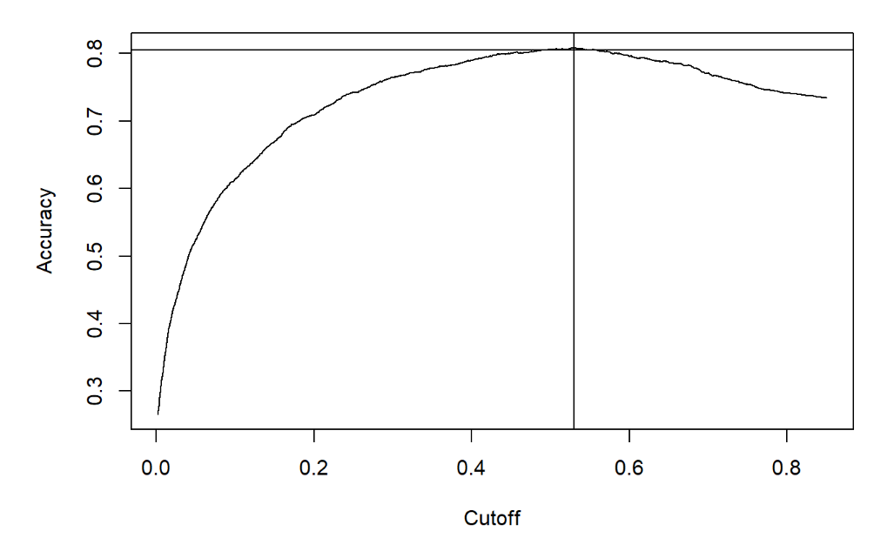
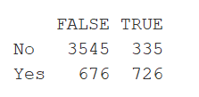
ROCR for accuracy of model
With a cutoff of 0.53.
True positive rate is 68.43%
False positive rate is 16.02%
This model has an accuracy of 80.86%

Slide 23
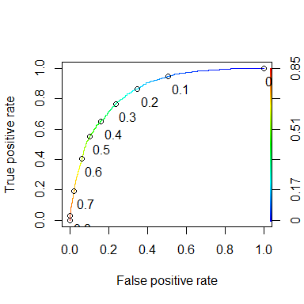
Using an ROC Curve
The ROC Curve helps us choose a better cut of point for the predictive model.
The AUC or area under the curve of this model is 0.8476
This also lets us know that the accuracy of the model is 84.76%

Slide 24
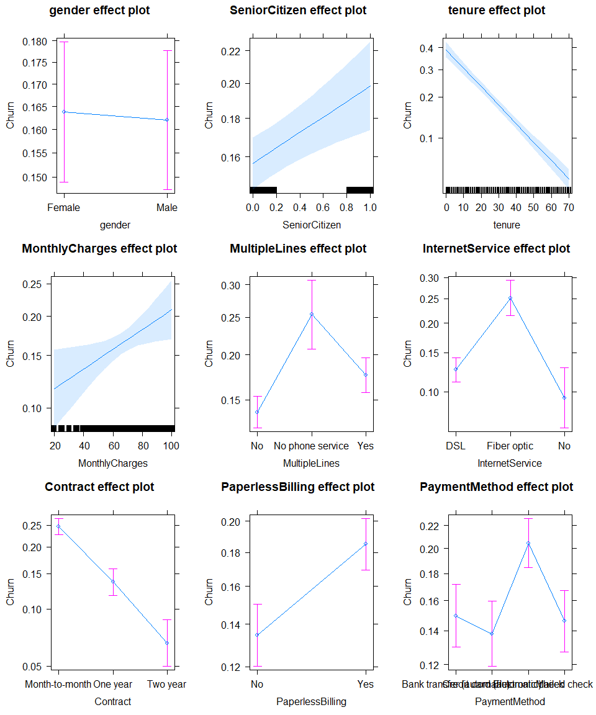
Using the model to predict Churn Patterns

Slide 25
Conclusions
The telecom customer churn analysis depicts various interesting results some of which include:
1. Females are ~0.2% more likely to churn
2. Senior Citizens are ~4% likely to churn
3. Customers with tenure of 0 months are ~40% more likely to churn compared to customers with tenure of 72 months. Between 0 to 40 months the customer is likely to churn. The company should focus on their services during this period.
4. Higher monthly charges to customers are more likely to churn. A customer paying $100 monthly is 1.75x more likely to churn than that of a customer paying ~$20 per month
5. Customers with multiple lines are 1.3x more likely to churn compared to people with no multiple lines (single line). Customers with no phone service are 1.9x more likely to churn in comparison with single line service.
6. Customers with Fiber Optics are 2.7x more likely to churn in comparison to customers with no internet service. While DSL customers are 1.4x likely to churn compared to customers with no internet service.
7. Month to Month customers are 3.5x more likely to churn than a two year contracted customer. While a one year contracted customer is 1.8x more likely to churn than a two year contracted customer.
8. Customers with paperless billing are 1.37x more likely to churn than those receiving their monthly bill in the mail.
9. Customers paying with Electronic Check are 1.4x more likely to churn in comparison to customers paying in credit card. While customers paying by bank transfer were 1.07x and customers paying by mailed check was 1.03x more likely to churn in comparison to customers paying in credit card.

Slide 26
Recommendations
More research would need to be done to see if these trend are specific to this data set or can be used to speak of other telecom data sets as well.
Adding more detailed variables such as the price of each service, the location of the customer, demography, and age of customer would lead to further insight from the data.

